Slide 1
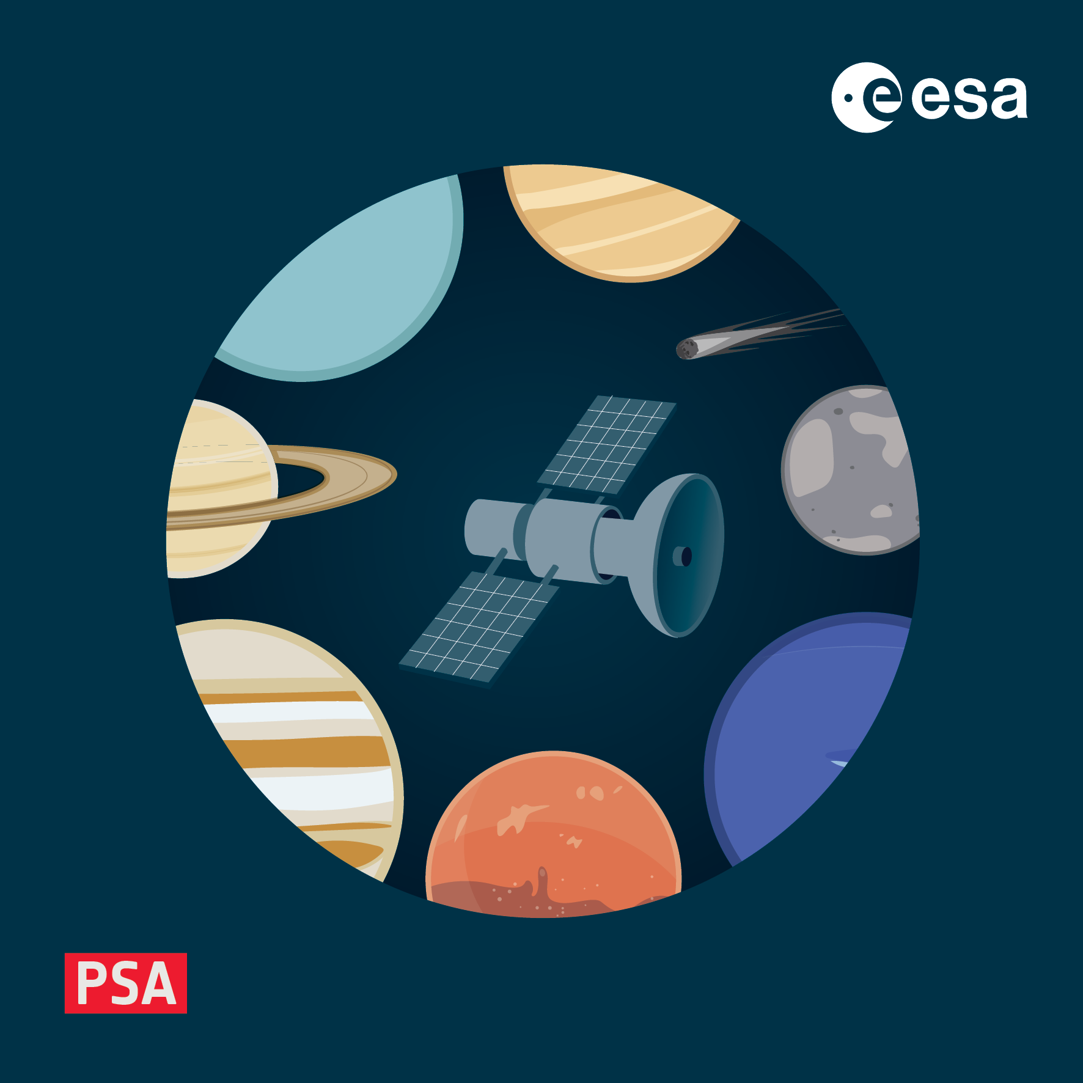
Types of PDS4 products
4-8 November 2024, ESAC, Spain

Slide 2
Take home message
In PDS4, everything is a PDS4 product
Basic products can be data, documents, images, …
Collections group the data products,
Bundles aggregate the collections,
All the above must have a PDS4 label file (*.xml, *.lblx) describing their content, provenance, etc.
Some products are labels only
Before starting designing a PDS4 product, think about what the product will contain
Actual measured data?
Supporting derived/computed data?
Documents, reports?
Specific information is required for specific product types

Slide 3
The most common types of PDS4 products
To organise/contextualise the archive
(Archive Scientist + Data Provider)
To archive the data products
(Data Provider)
Product_Context
You may provide/fill these
(Archive Scientist involved)
Product_Document
You will provide these
Product_Bundle
You may provide/fill these
(→ data delivery method)
Product_Observational
You will provide these
Product_Collection
You may provide/fill these
(→ data delivery method)
Product_Ancillary
You may provide these
Product_XML_Schema
You may provide/fill these
(Archive Scientist involved)
Product_Browse
You will provide these
[…]

Slide 4
The most common types of PDS4 products
To organise/contextualise the archive
(Archive Scientist + Data Provider)
To archive the data products
(Data Provider)
Product_Context
You may provide/fill these
(Archive Scientist involved)
Product_Document
You will provide these
Product_Bundle
You may provide/fill these
(→ data delivery method)
Product_Observational
You will provide these
Product_Collection
You may provide/fill these
(→ data delivery method)
Product_Ancillary
You may provide these
Product_XML_Schema
You may provide/fill these
(Archive Scientist involved)
Product_Browse
You will provide these
[…]

Slide 5
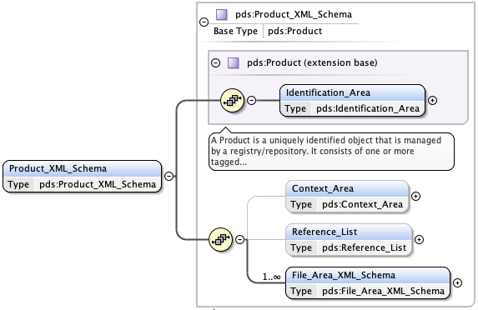
Product_XML_Schema
What is an XML Schema product?
A product consisting of XML formatted schemas, Schematron files, or any other reference schemas used in the interpretation of an observational product.
Typically used for creating PDS4 dictionaries (mission, instrument, discipline, etc) automatically, using the LDDTool → More on this later this week!
Mandatory classes:
Identification area
File Area XML Schema (one per data file of the product)

Slide 6
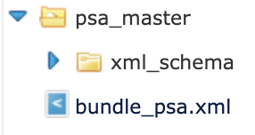
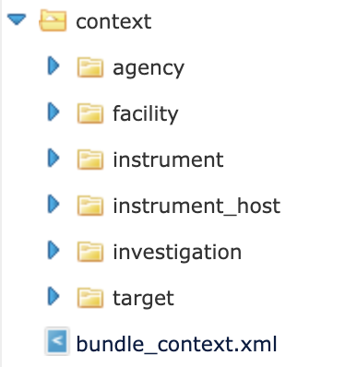
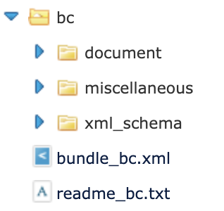
Product_Bundle
What is a bundle product?
The bundle is the largest logical structure in PDS4 (typically used for a mission, for an instrument, …).
Aggregate PDS4 product that “stitches” together collections of data products.
The product has a table of references to one or more collections.
PSA master and context bundles example
PSA bundle
Collections
BepiColombo (bc) mission example
Bundle product
Collections
PSA context bundle
Collections
Bundle product
(label + *.txt description)
Bundle product

Slide 7
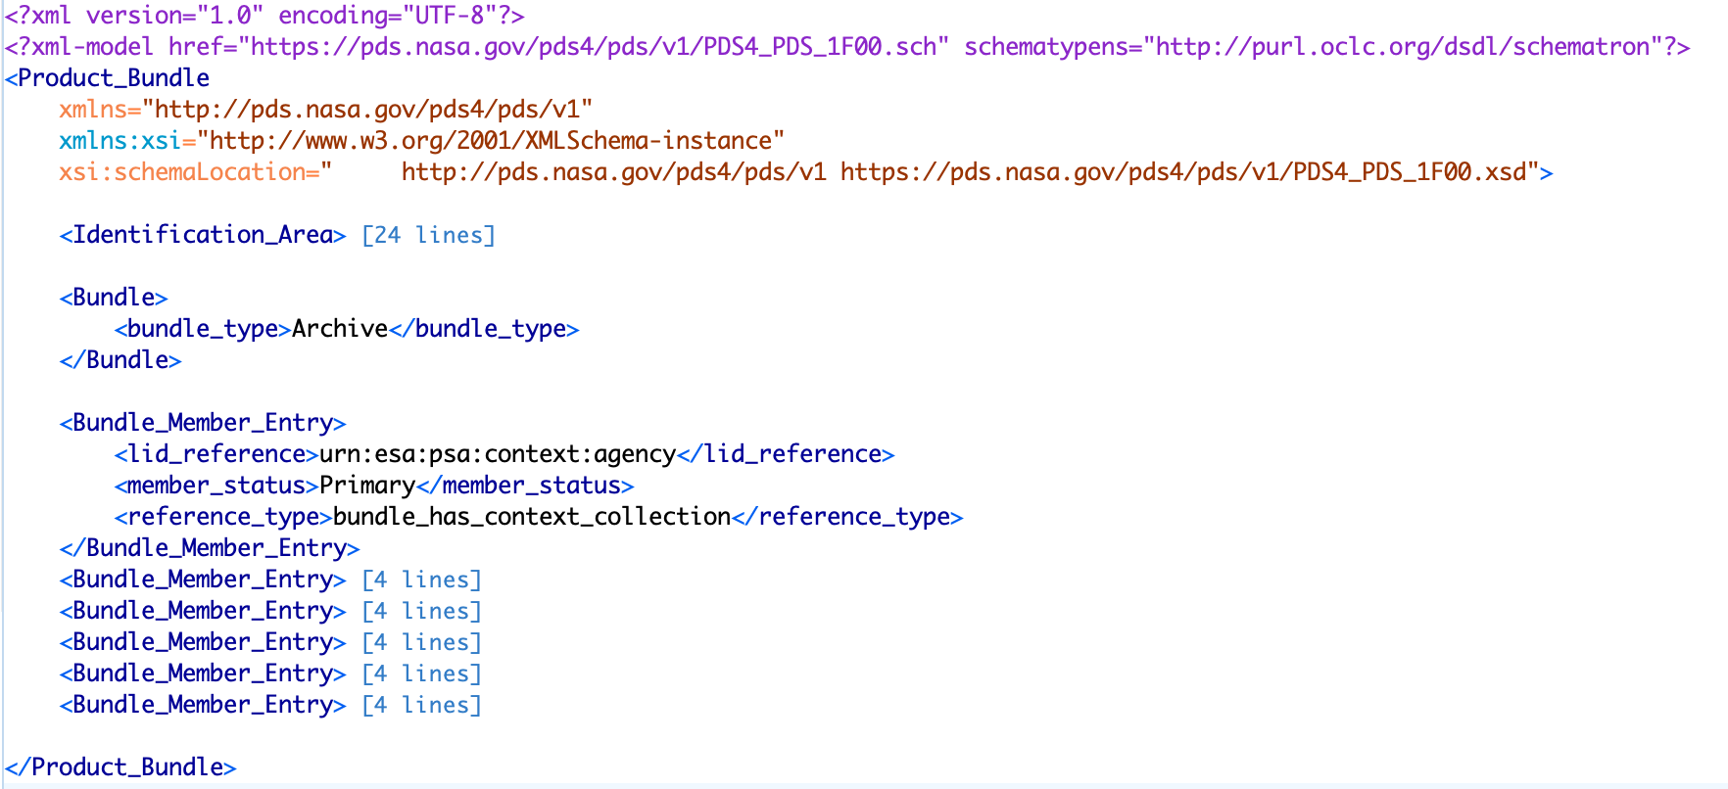
Product_Bundle: PSA Context bundle

Slide 8
Product_Bundle: PSA Context bundle
The product is an archive bundle

Slide 9
Product_Bundle: PSA Context bundle
The bundle references all the collections existing in the bundle

Slide 10
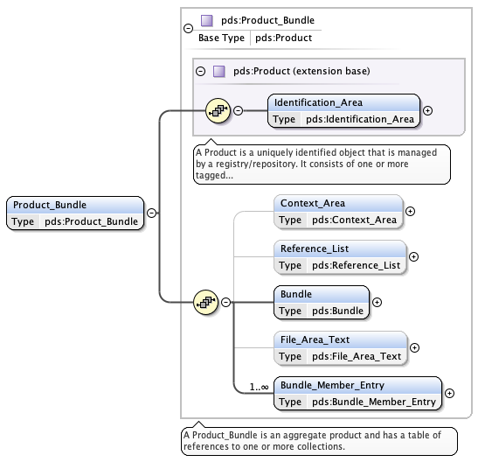
Product_Bundle
Mandatory classes:
Identification area
Bundle
Bundle Member Entry
Optional classes:
Better to fill as much as possible to relate a bundle to its context
Mandatory classes
Optional classes

Slide 11
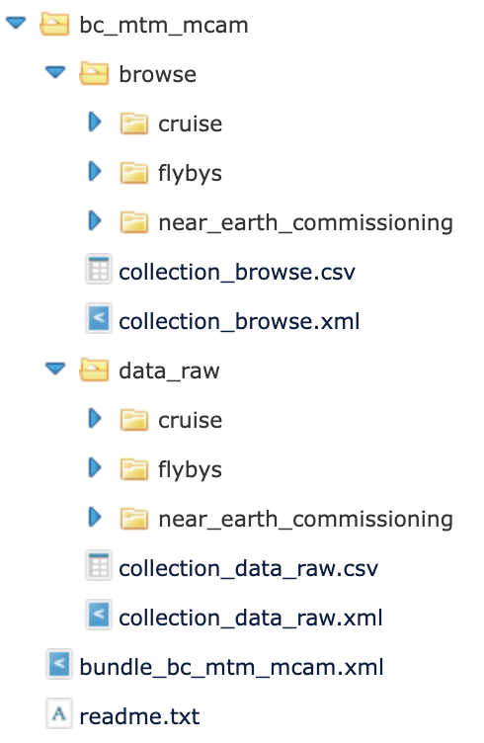
Product_Collection
What is a collection product?
A product that has a table of references (called inventory) to one or more basic products.
Usually in the PSA, a collection within an instrument bundle will capture the processing level (e.g. data_raw) or type of the data product (e.g. document).
Browse products collection
PDS4 collection product for the browse collection
(label + inventory)
BepiColombo
MCAM bundle
Raw data collection
PDS4 collection product for the raw data collection
(label + inventory)

Slide 12
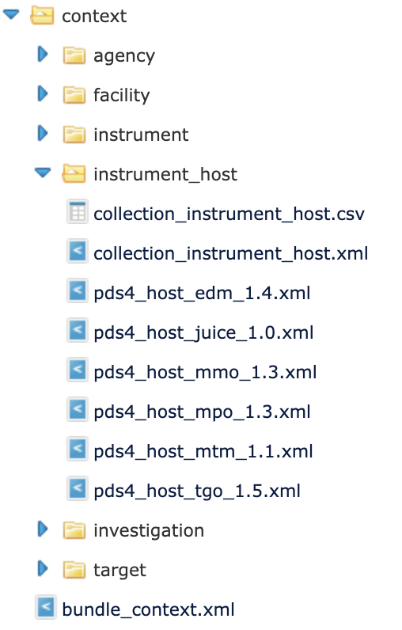
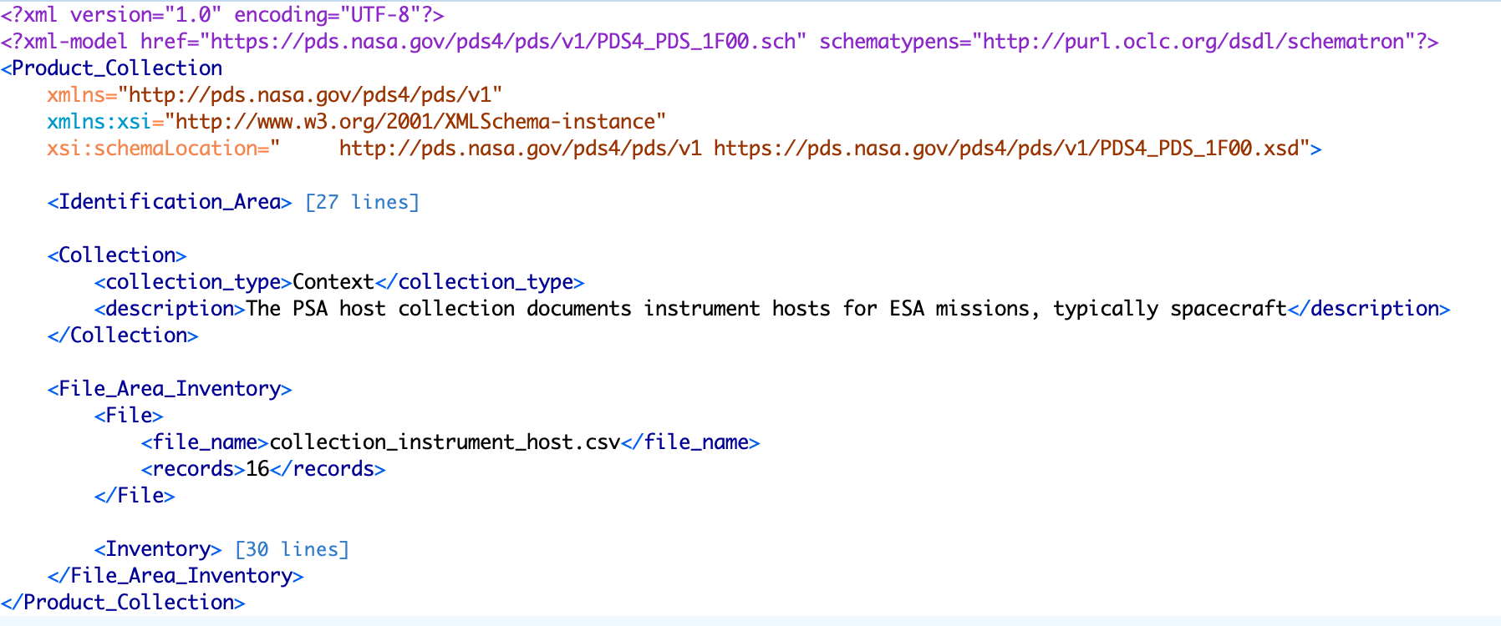
Product_Collection: Instrument host collection
https://psaftp.esac.esa.int/

Slide 13
Product_Collection: Instrument host collection
https://psaftp.esac.esa.int/

Slide 14
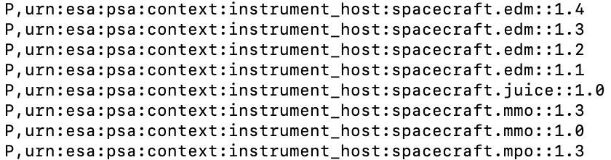
Product_Collection: Instrument host collection
https://psaftp.esac.esa.int/
Contains
Defines
Collection inventory = comma separated value file
Member type: Primary (P, if the product is in the collection), or Secondary (S)
lidvid of the data products in the collection

Slide 15
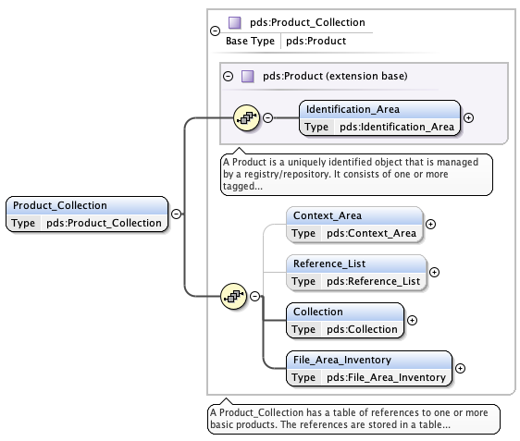
Product_Collection
Mandatory classes:
Identification area
Collection
File Area Inventory
Optional classes:
Better to fill as much as possible to relate a bundle to its context
Mandatory
Optional

Slide 16
Product_Collection: Reminder on expected collections
document
browse_<level>*
data_<level>*
Expected
Optional by the instrument
Optional by the mission (only secondary members)
Instrument
bundle
calibration_<level>* calibration_files
geometry
miscellaneous
context
xml_schema
*<level> can be raw, partially_processed, calibrated, derived

Slide 17
Product_Context
What is a context product?
PDS4 product that provides the physical (instrument, instrument host, facility, target) or conceptual (e.g. investigation) context and provenance.
The products should be created as soon as possible together with the Archive Scientist.
Good guidelines available on the PDS website (Guide to context products)
Investigation | Host | Instrument | Target
Science | Where? | How? | For What?
Mission Non-mission Individual Investigation Observing Campaign Field Campaign Other Investigation | Instrument host Spacecraft Rover Lander Facility Laboratory Observatory | Instrument Telescope | Planets Satellites Samples Calibration …

Slide 18
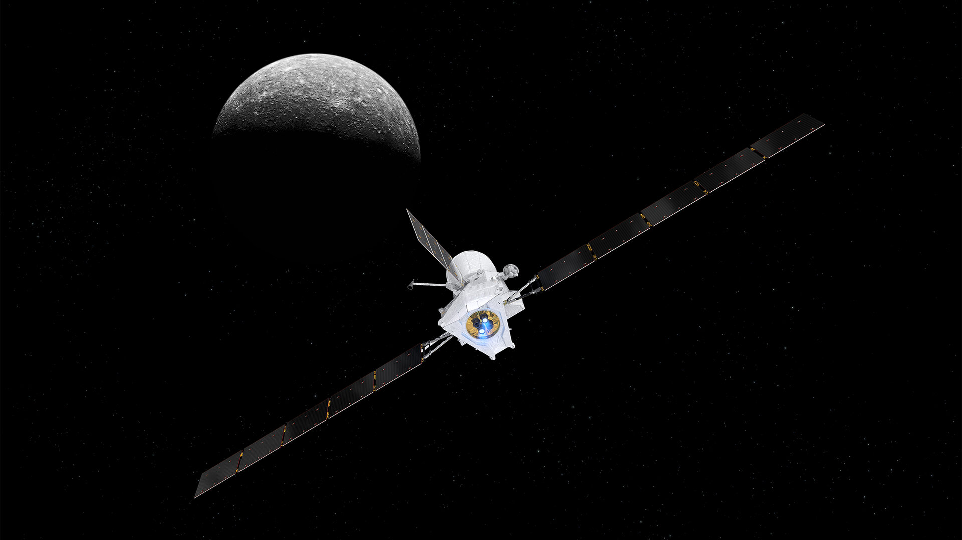
Product_Context: Hierarchy
The BepiColombo science investigation (mission)
The ESA Mercury Planetary Orbiter (MPO) is part of the mission
MPO hosts many instruments, of which the magnetometer MPO-MAG
The MPO-MAG can observe Mercury

Slide 19
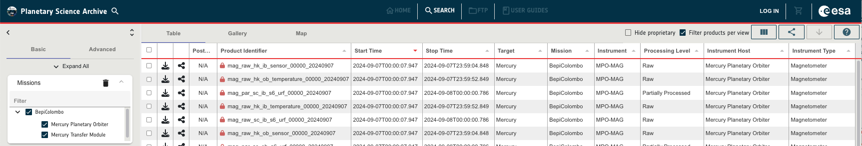
Product_Context: Practical usage
The context products relate the data to their instrument, target, host/facility, investigation entities in the archive.
The products can be found in the archive using searches on those entities (need to be referenced in the labels).

Slide 20
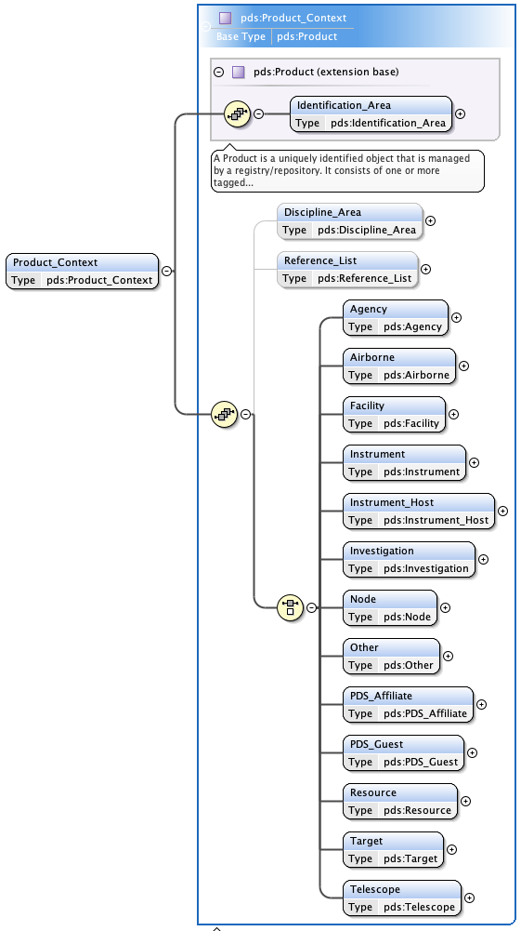
Product_Context
Depending on the type of context products, specific information will be required to be filled.
Context products must be created jointly with your Archive Scientist.
Mandatory classes:
Identification area
One of the many classes of type of context
The required information for the context selected
Optional classes:
Reference List can be useful to relate context products
Mandatory
Optional

Slide 21
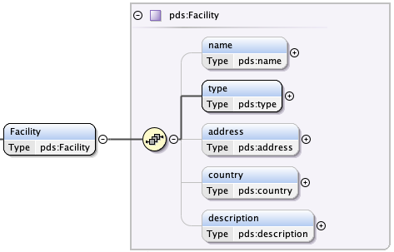
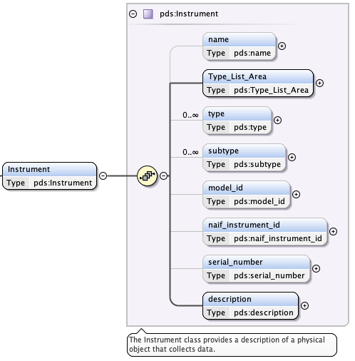
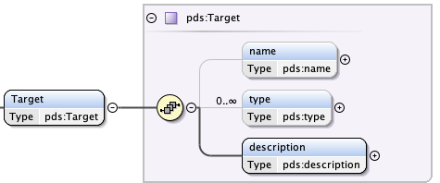
Product_Context: Some examples of classes
Any instrument
Laboratories
Observatories
Planets, Satellites,
Stars,
Calibration, Samples
Mandatory
Optional

Slide 22
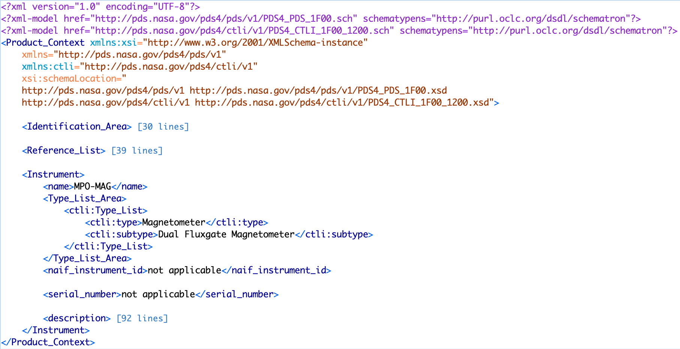
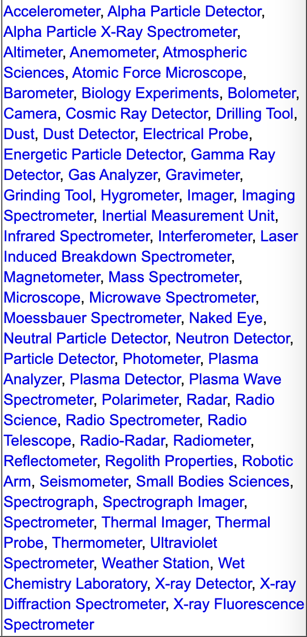
Product_Context: Instrument class
The instrument type is mandatory.
PDS pre-defined list of instrument types.
Further details needed? use the subtype.
The description is mandatory.
Mandatory
Optional

Slide 23
We have seen so far…
INSTRUMENT BUNDLE
Product_Bundle
CONTEXT
COLLECTION
Product_Collection
INVESTIGATION
Product_Context
data_*
Product_Collection
INSTRUMENT_HOST
Product_Context
PDS4 DICTIONARIES
Product_XML_Schema
FACILITY
Product_Context
document
Product_Collection
What goes there?
INSTRUMENT
Product_Context
geometry
Product_Collection
TARGET
Product_Context
calibration
Product_Collection

Slide 24
The most common types of PDS4 products
To organise/contextualise the archive
(Archive Scientist + Data Provider)
To archive the data products
(Data Provider)
Product_Context
You may provide/fill these
(Archive Scientist involved)
Product_Document
You will provide these
Product_Bundle
You may provide/fill these
(→ data delivery method)
Product_Observational
You will provide these
Product_Collection
You may provide/fill these
(→ data delivery method)
Product_Ancillary
You may provide these
Product_XML_Schema
You may provide/fill these
(Archive Scientist involved)
Product_Browse
You will provide these
[…]

Slide 25
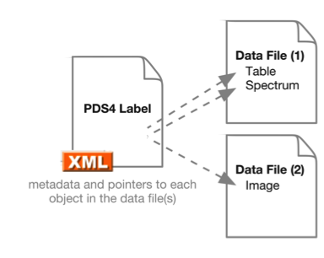
Basic products: Reminder
A PDS4 product consists in zero to several data file(s) wrapped into one single label.

Slide 26
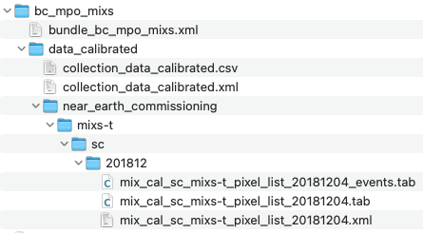
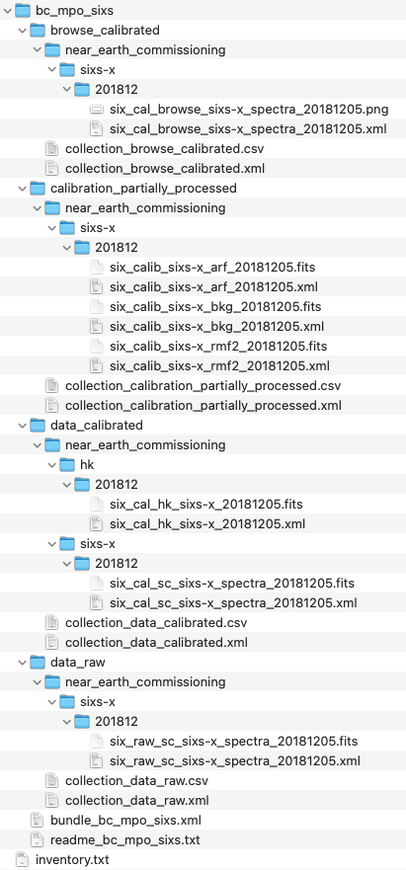
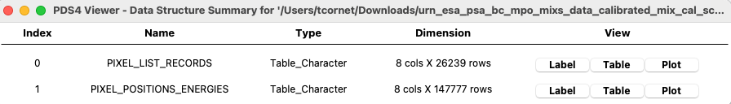
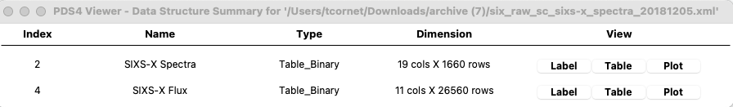
Product_Observational
What is an Observational Product?
A set of one or more information objects produced by an observing system.
Most commonly used type of PDS4 product for the measured science or engineering observation data.
A single PDS4 observational product can contain one to many data structures (arrays, tables, …)
1 PDS4 product, 2 data files, 2 tables
1 PDS4 product, 1 data file, 2 tables

Slide 27
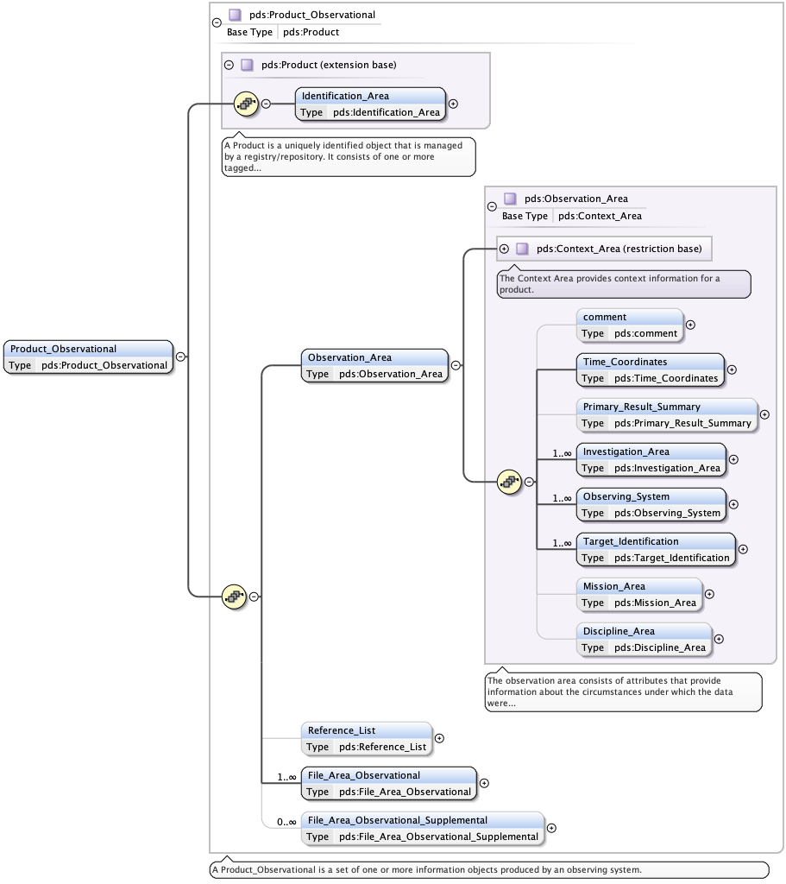
Product_Observational
What is an Observational Product?
Probably the product type for which the most complete set of metadata are required, + links to other data products (e.g. calibration products, browse images, documents, …)
When were the data taken?
For which purpose?
For which investigation (e.g. mission)?
Using which instrument on which host?
Observing which target?
+ info related to the mission / the archive (PSA)
+ very specific info related to disciplines

Slide 28
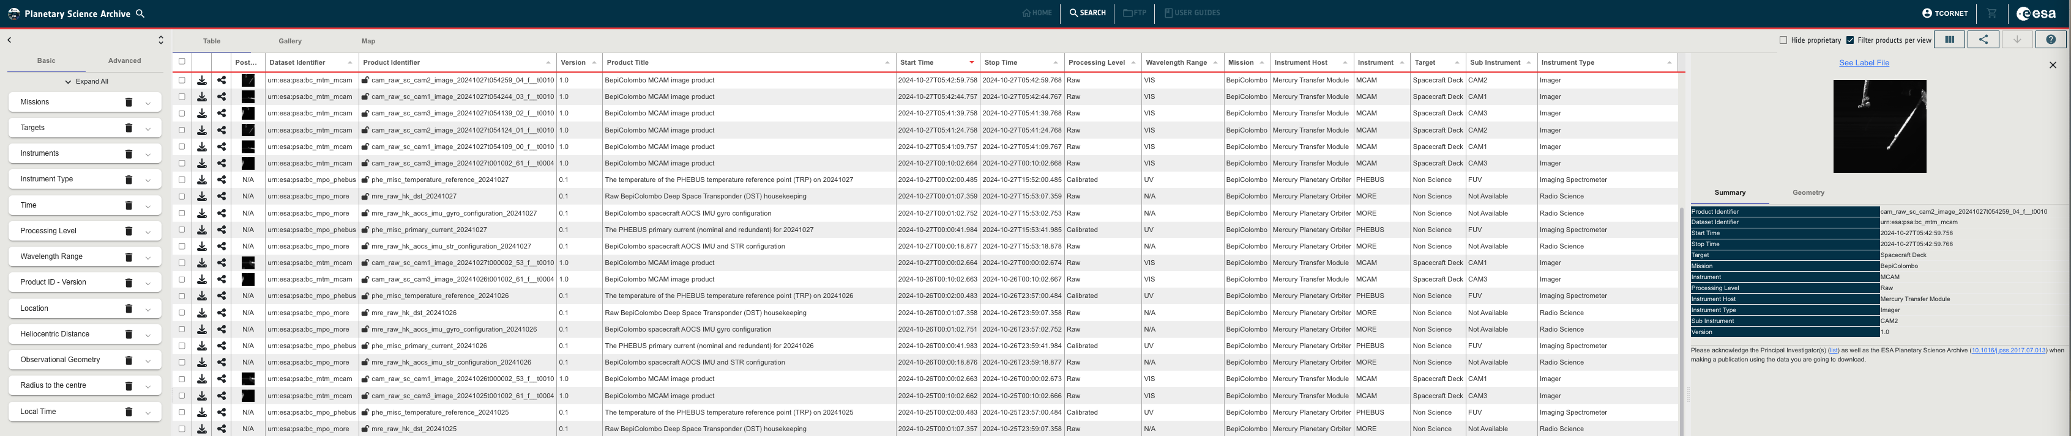
Product_Observational
What is an Observational Product?
Probably the product type for which the most complete set of metadata are required, + links to other data products (e.g. calibration products, browse images, documents, …)
Actively used to make data discoverable in the PSA!
Identification Area
Observation Area
Discipline Area (e.g. Geometry)

Slide 29
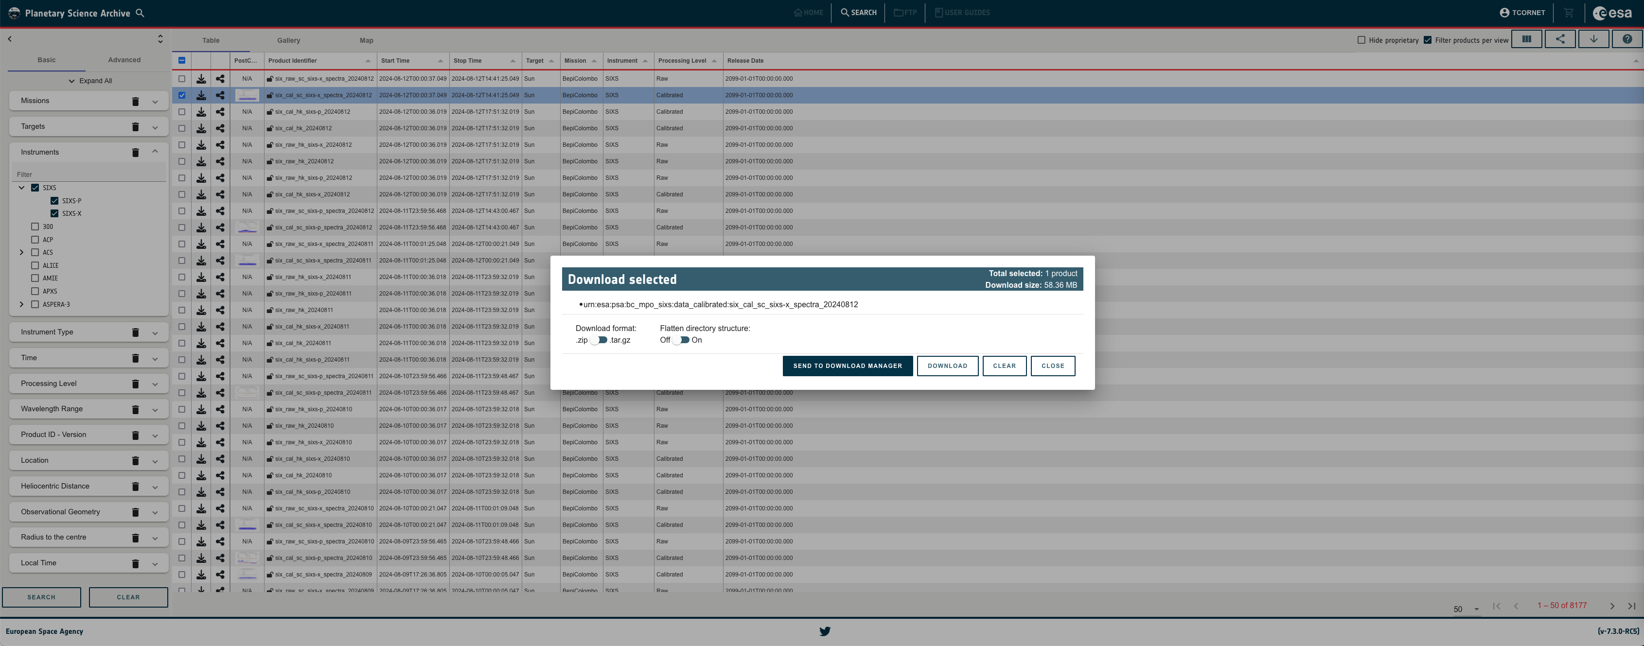
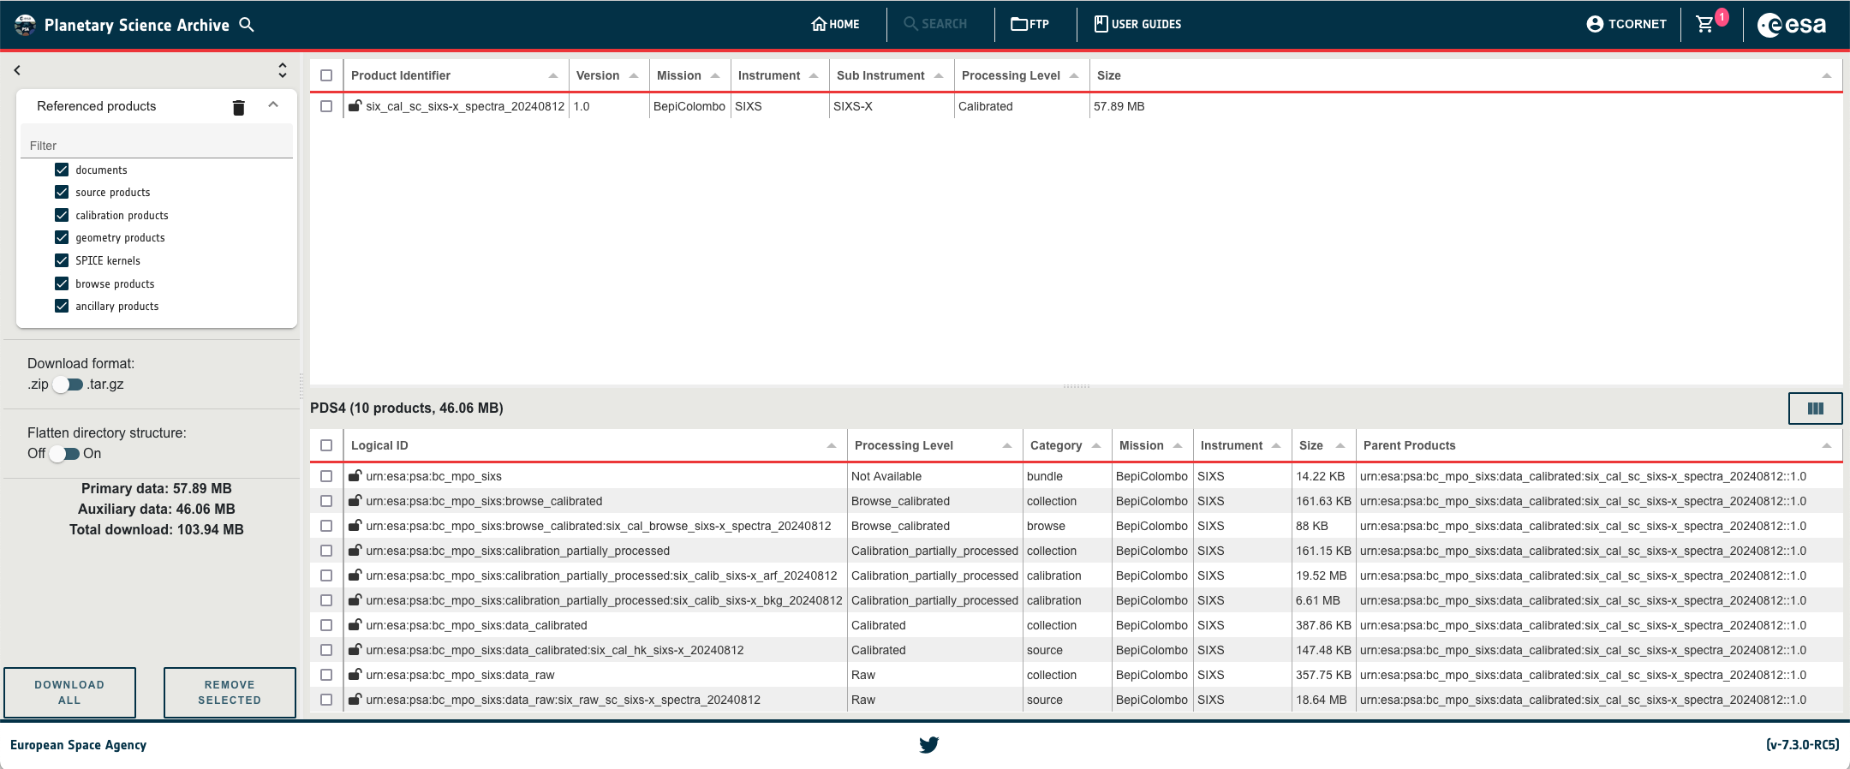
Product_Observational: Connection to other products
Download Manager in the PSA
https://psa.esa.int/
Product (Observational) selected for download
Referenced other products to add to the download

Slide 30
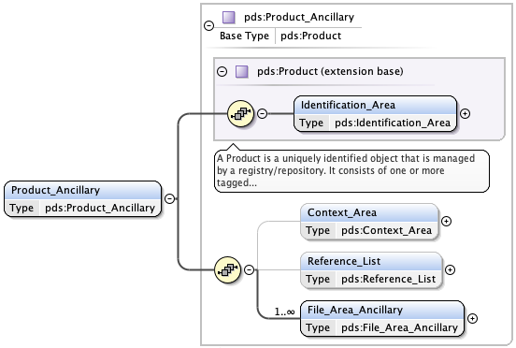
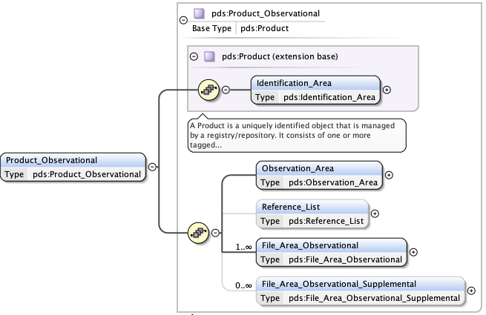
Product_Ancillary
What is an Ancillary Product?
A product similar to a Product_Observational that contains data that are supplementary to observational data.
Typical use: Calibration files, geometry data relevant to observations, …
Use the Reference_List to establish logical links between the ancillary data and the observational data.
By default, the PSA only shows the Product_Observational in the user interface.

Slide 31
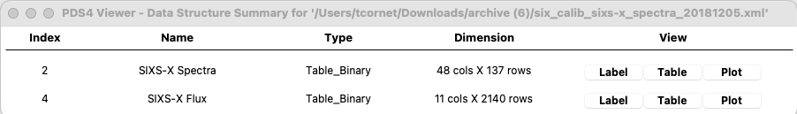
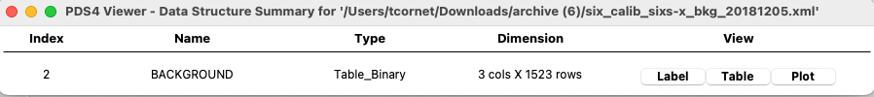
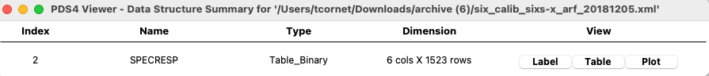
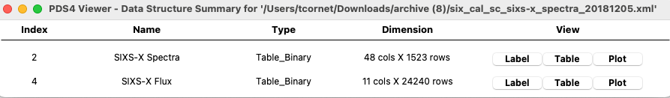
Product_Ancillary: Example of BepiColombo SIXS-X
Raw science data
1 Product_Observational with 2 binary tables
→ data_raw collection
Partially processed science data
3 Product_Ancillary with binary tables
→ calibration_partially_processed collection
Calibrated science data
1 Product_Observational with 2 binary tables
→ data_calibrated collection

Slide 32
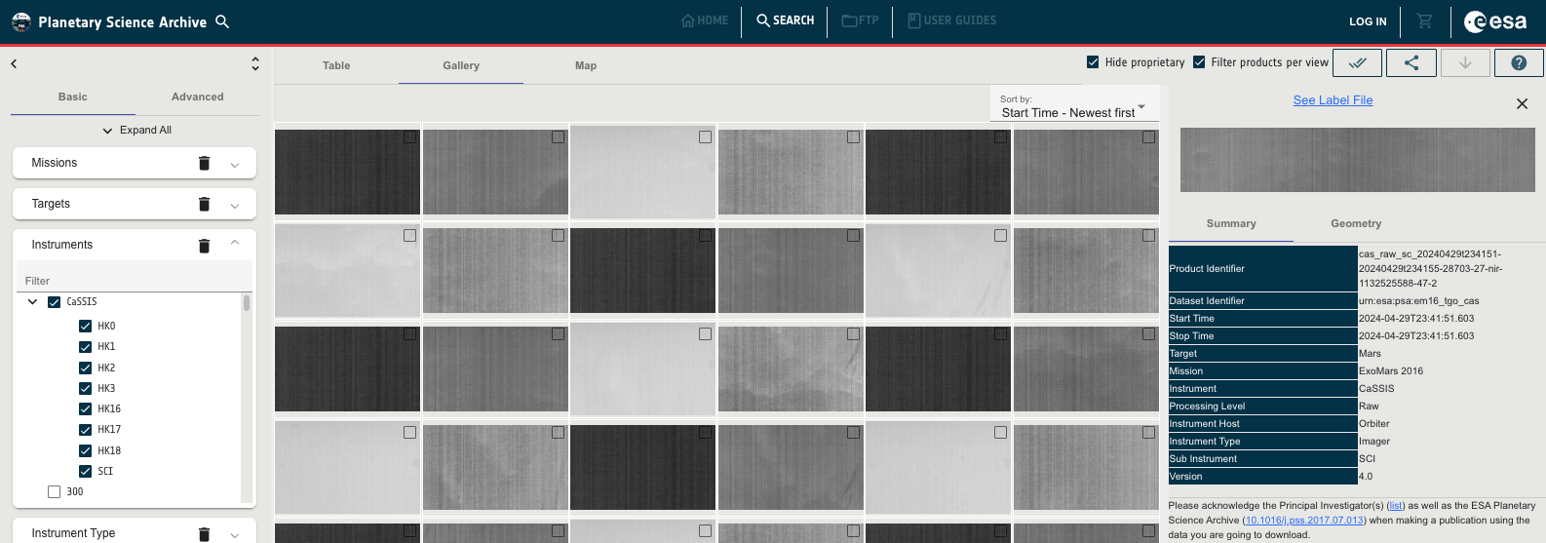
Product_Browse (and Product_Thumbnail)
What is a Browse Product?
A product consisting of one encoded byte stream digital object.
Note: Product_Thumbnail is similar, but the PSA uses Product_Browse
Low resolution “quick-look” of observational science or engineering data.

Slide 33
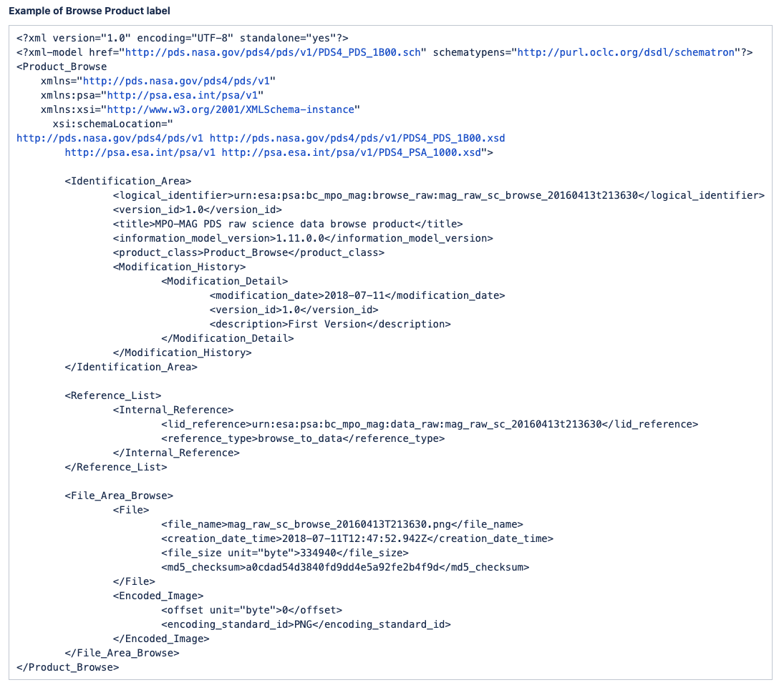
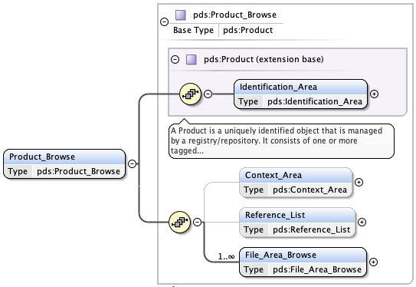
Product_Browse (and Product_Thumbnail)
Example in the PSA PDS4 Archiving Guide (Section 5.5)
Using Encoded_Image in the File_Area_Browse (*.jpg or *.png, >512pixels, small size in MB).
Use Internal_Reference to link data and browse products.

Slide 34
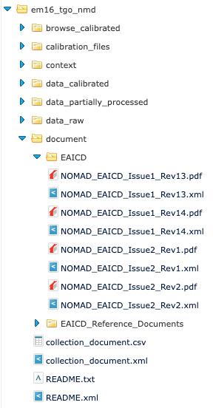
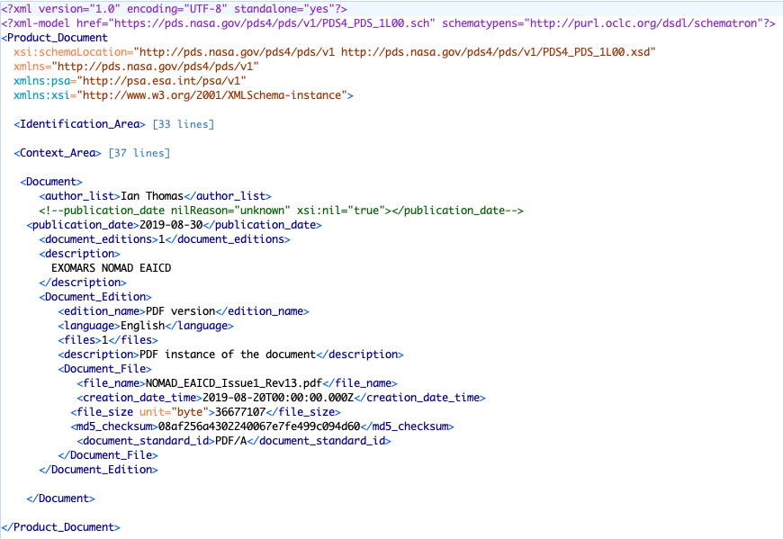
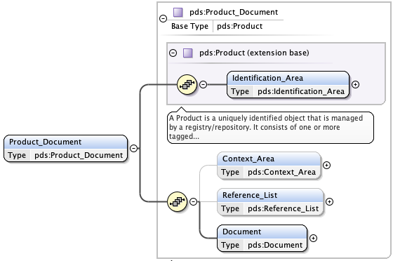
Product_Document
What is a Document Product?
A product consisting of a single logical document that may comprise one or more document editions.
Typical examples: User Manuals, Data User Guide / EAICD, Calibration reports, …

Slide 35
More products (less common to data providers)
Product_SPICE_Kernel: A SPICE kernel product (mostly used by the SPICE services).
Product_External: A product that does not reside within the PDS archives. Must not be abused.
Product_File_Text: A product that consists of a single text file with ASCII character encoding (e.g. bundle readme file).
Product_Metadata_Supplemental: A product to provide new, and/or improved, metadata for some or all of the basic products in a single collection.
Product_Native: A product to describe digital objects in the original format returned by the spacecraft or experimental system when that format cannot be described using one of the PDS4 formats specified for observational data (tables or arrays, excluding Array_1D). Only supports one specific encoding.

Slide 36
Summary
INSTRUMENT BUNDLE
Product_Bundle
CONTEXT
data_*
Product_Collection
Product_Observational
INVESTIGATION
Product_Context
browse_*
Product_Collection
Product_Browse
INSTRUMENT_HOST
Product_Context
PDS4 DICTIONARIES
Product_XML_Schema
FACILITY
Product_Context
document
Product_Collection
Product_Document
INSTRUMENT
Product_Context
geometry
Product_Collection
Product_Ancillary
TARGET
Product_Context
calibration_*
Product_Collection

